Slide 1
EAT IN NYC?
NYC Restaurant Inspections

Slide 2
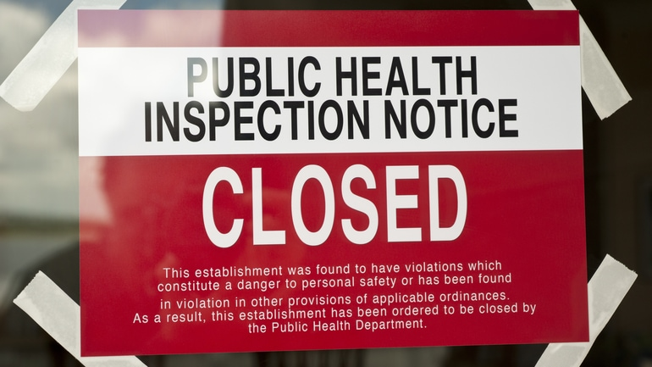
Project Team
Christina Hawkins
Jordan Gilmartin
Lynell Robinson
Min Xie
Nick Mangarella

Slide 3
Project Theme
With the millions of people and variety of cultures in the New York City area, there are thousands of restaurants to choose from.
If you are going to spend your money in a restaurant, you want to know the restaurant is up to code, especially during these times.
So how well are restaurants doing in NYC when it comes to health inspections

Slide 4
Dataset
DOHMH New York City Restaurant Inspection Results
https://www.kaggle.com/sdawar/dohmh-newyork-city-restaurant-inspection-results
Potential Questions for Visualizations
Question 1 | What restaurants had no violations in their initial inspection?
Question 2 | What restaurants had to go for re-inspection?
Question 3 | Were restaurants able to improve their scores on the re-inspection?
Question 4 | What restaurants had to go for a second re-inspection?
Question 5 | What restaurants had to close?
Question 6 | What restaurants we able to reopen?
Question 7 | Were restaurants with critical violations able to pass inspection?
Question 8 | Is there a correlation between cuisine and violation count?
Question 9 | Is there a correlation between location and violation count?

Slide 5
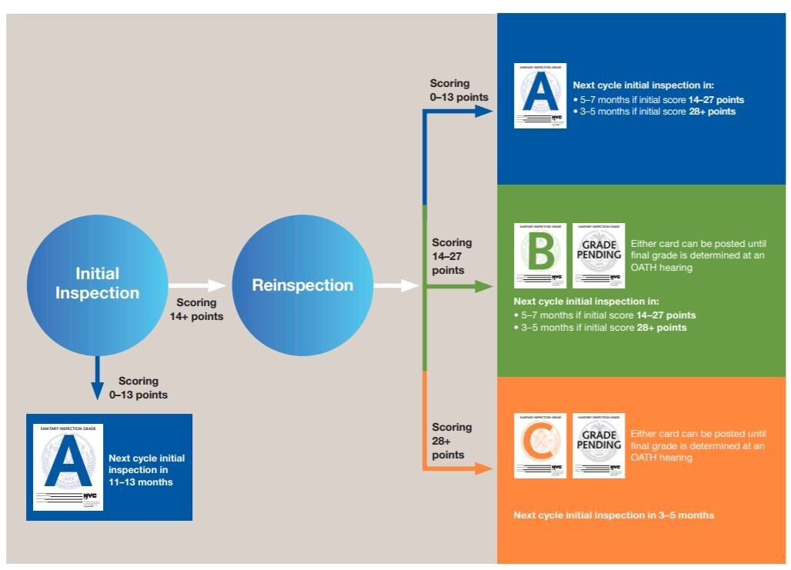
NYC Inspections

Slide 6
Coding Approach
Work
Backend | Data Clean Up | Lynell
Backend | SQLite, SQLAlchemy, Flask | Jordan
Front End | JavaScript/ Visualizations | Nick
Front End | JavaScript/ Visualizations | Min
Front End | New JavaScript Library/ Visualizations | Lynell
Front End | HTML | Christina

Slide 7
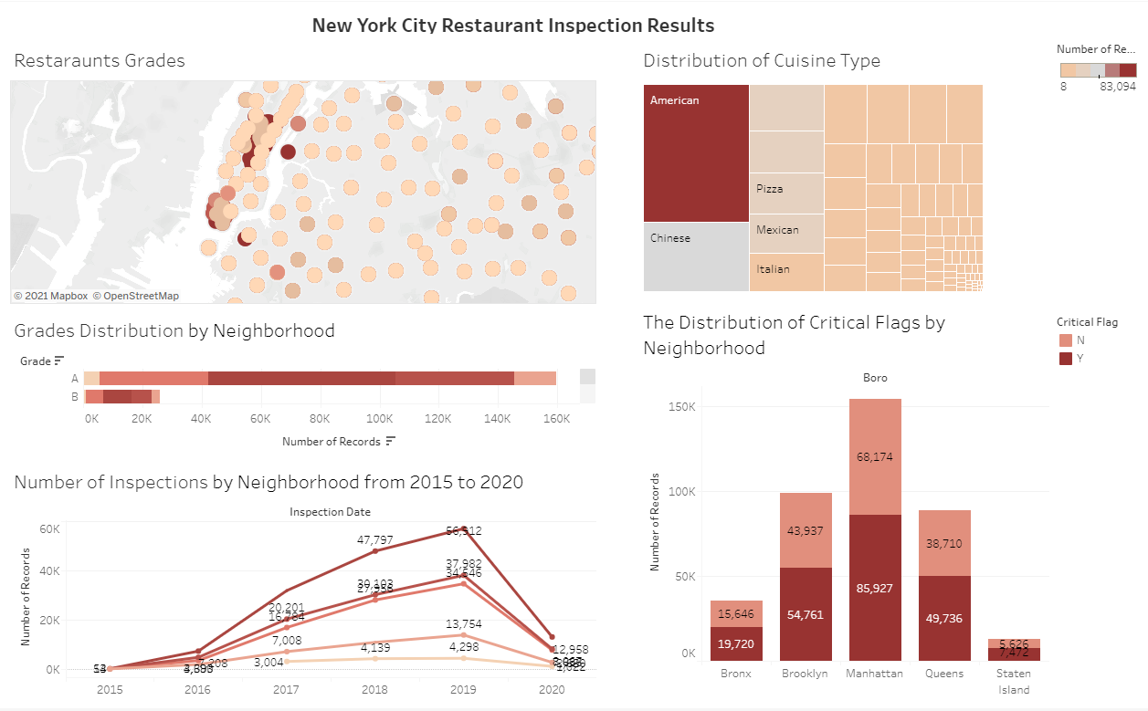
Potential Visualization Layout

Slide 8
Project Challenges
Getting to a workable Dataset
Choosing and cleaning the Dataset
Visualizations to match the current Dataset
Deployment
Dataset Decisions
Cleaning
Backend
Visualizations

Slide 9
Project Challenges
Repo Examples
Dataset Decisions
Cleaning
Backend
Visualizations

Slide 10
Final Product
Product Demo

